Slide 1
Artificial Intelligence
Logical Agents – Predicate Logic

Slide 2
Contents
Logical Agents
Predicate Logic – Introduction

Slide 3

Limitations of PL
Limited expressiveness
- Propositional logic only talks about whole statements being true or false.
- It cannot break a statement into smaller parts (like objects, properties, or relationships).
Eg:
P = Roommate is carrying an umbrella.
We can say things like
Rain → P (If it rains, the roommate carries an umbrella).
But we cannot express
- All roommates carry an umbrella when it rains.
- Some roommates forget their umbrella.
- Roommate is carrying two umbrellas.

Slide 4

Limitations of PL
To say these, you would need variables (like x, y), quantifiers (all, some), and relations—which propositional logic doesn’t have.
Becomes impractical, even for very small worlds
Not possible to represent relations like all, some, or none with propositional logic
Cannot represent objects, properties and relationships

Slide 5

Language of thoughts
Natural languages are very expressive
Natural languages also suffer from ambiguity, a problem for a representation language
Combining the formal and natural languages
  foundation of propositional logic—a declarative, compositional semantics that is context-independent and unambiguous
  representational ideas from natural language while avoiding its drawbacks
Nouns and noun phrases refer to objects (squares, pits, wumpuses)
Verbs and verb phrases refer to relations among objects (is breezy, is adjacent to, shoots)
Relations are functions—relations in which there is only one
“value” for a given “input.”

Slide 6

Objects: people, houses, numbers, theories, Ronald McDonald, colors, baseball games, wars, centuries . . .
Relations: these can be
- unary relations or properties such as red, round, bogus, prime, multistoried.
- or more general n-ary relations such as brother of, bigger than, inside, part of, has color, occurred after, owns, comes between
Functions: father of, best friend, third inning of, one more than, beginning of

Slide 7

Examples
“One plus two equals three.”
  Objects: one, two, three, one plus two
  Relation: equals
  Function: plus
(“One plus two” is a name for the object that is obtained by applying the function “plus” to the objects “one” and “two.” “Three” is another name for this object.)
“Squares neighboring the wumpus are smelly.”
  Objects: wumpus, squares
  Property: smelly
  Relation: neighboring
“Evil King John ruled England in 1200.”
  Objects: John, England, 1200
  Relation: ruled
  Properties: evil, king
predicate symbols stand for relations

Slide 8

Predicate Logic
Predicate Logic is built around objects and relations
extends the syntax of propositional calculus with predicates
and quantifiers
P(X) – P is a predicate
Models for first-order logic
Models of a logical language are the formal structures that
constitute the possible worlds under consideration.
Each model links the vocabulary of the logical sentences to elements of the possible world, so that the truth of any sentence can be determined.

Slide 9

Models for first-order logic are much more interesting.
- First, they have objects in them!
The domain of a model is the set of objects or domain elements it contains.
The domain is required to be nonempty—every possible world must contain at least one object

Slide 10
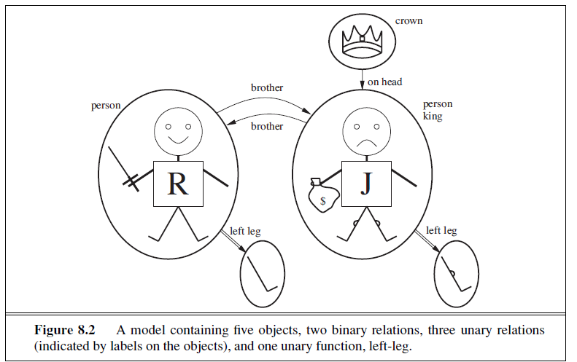
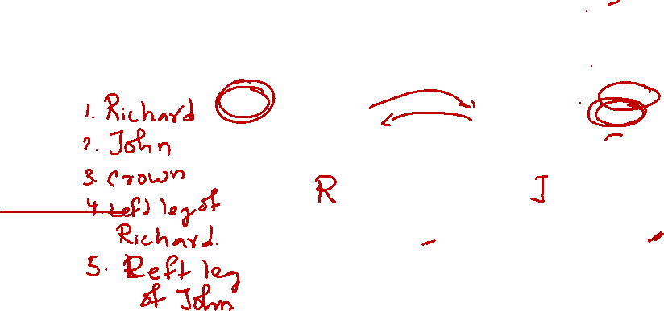
Notes:
Unary relation – describe the property of a single object
Binary relation – describe relation between two objects

Slide 11

Relation
The objects in the model may be related in various ways.
- In the figure, Richard and John are brothers.
Formally speaking, a relation is just the set of tuples of objects that are related.
(A tuple is a collection of objects arranged in a fixed order and is written with angle brackets surrounding the objects.)
Thus, the brotherhood relation in this model is the set

Slide 12

Binary and Unary relations
The crown is on King John’s head, so the “on head” relation contains just one tuple,
The “brother” and “on head” relations are binary relations—that is, they relate pairs of objects.
The model also contains unary relations, or properties:
1) the “person” property is true of both Richard and John;
2) the “king” property is true only of John
3) the “crown” property is true only of the crown.

Slide 13
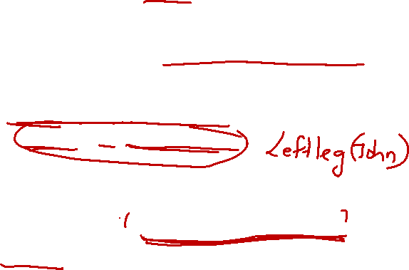
Total functions
Some relationships always give exactly one answer for each object.
Example: “left leg” of a person.
For every person, there is one and only one left leg.
So we treat left leg like a function
  Leftleg function
  Richard → Richard’s left leg (Richard maps to Richard’s left leg.)
  King John → John’s left leg
When first-order logic treats something as a function,
it must return a result for every input, even when the input is odd.

Slide 14

Symbols and interpretations
The basic syntactic elements of first-order logic are the symbols that stand for objects, relations, and functions.
The symbols, therefore, come in three kinds
constant symbols, which stand for objects
predicate symbols, which stand for relations
function symbols, which stand for functions.
We adopt the convention that these symbols will begin with
uppercase letters.
Here, constant symbols Richard and John
-the predicate symbols Brother , OnHead, Person, King, and Crown
- the function symbol LeftLeg.

Slide 15

Interpretation
intended interpretation—is as follows:
• Richard refers to Richard the Lionheart and John refers to the evil King John.
• Brother refers to the brotherhood relation, that is, the set of tuples of objects given in
OnHead refers to the “on head” relation that holds between the crown and King John;
Person, King, and Crown refer to the sets of objects that are persons, kings, and crowns.
• LeftLeg refers to the “left leg” function, that is, the mapping given in previous section.

Slide 16
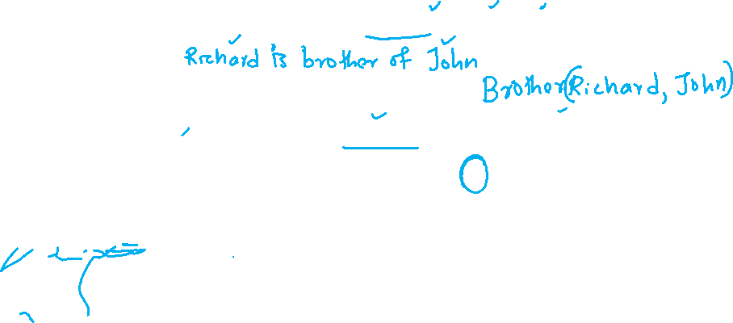
Predicate Logic
Term- A term is a logical expression that refers to an object. Constant symbols are therefore terms
Atomic sentence is formed from a predicate symbol optionally followed by a parenthesized list of terms/objects.
Atomic sentence = predicate (term₁,...,term_{n})
Ex:
Brother(Richard, John)
Married(Father(Richard), Mother(John)) Brother(Richard, John) ∧ Brother(John, Richard)
An atomic sentence is true in a given model if the relation referred to by the predicate symbol holds among the objects referred to by the arguments.
Notes:
Richard is the brother of King John

Slide 17
Syntax of FOL: Basic elements
The basic syntactic elements of FOL are the symbols that stand for objects, relations & functions.
Constants (stand for objects)
Predicates (stand for relation)
Functions (stand for function)
Variables
Connectives
Equality
Quantifiers
Susan, A, B,... Brother, Round,... FatherOf,...
x, y, a, b,...
¬, ⇒, ∧, ∨, ⇔
=
∀, ∃

Slide 18
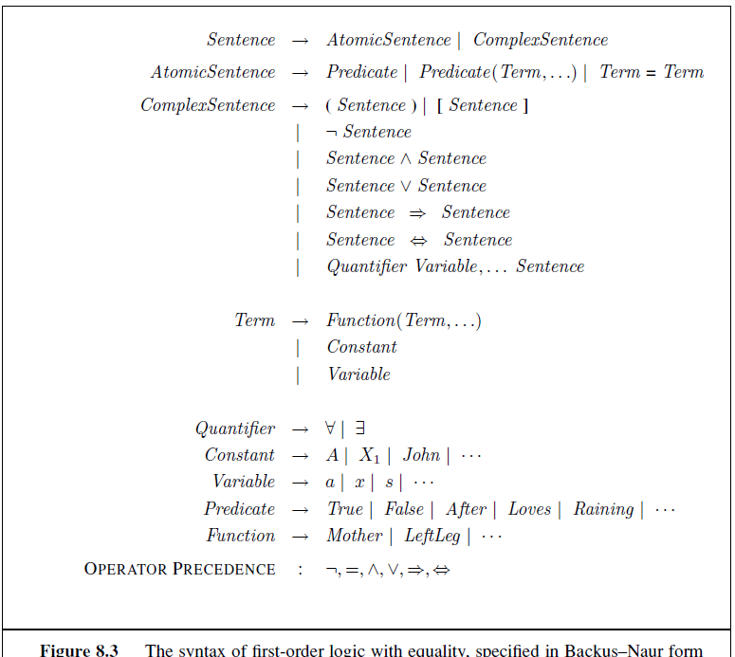

Syntax of FOL: Basic elements

Slide 19

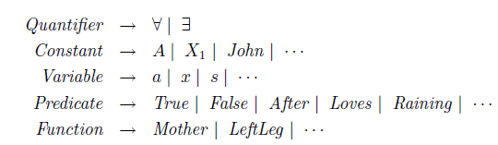

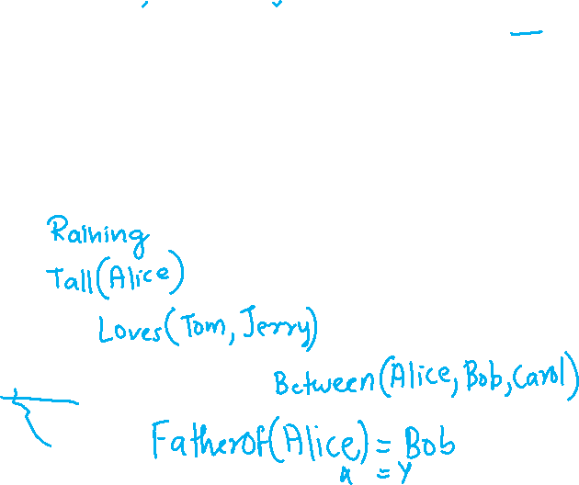
Atomic Sentence
a) It is raining
b) Alice is tall
c) Tom loves Jerry
d) Alice is between Bob and Carol
e) Alice's father is Bob

Slide 20
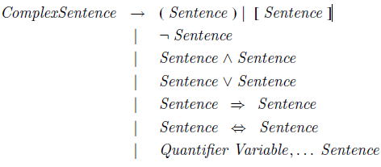

Complex Sentence
If Alice is tall and smart then she is happy

Slide 21
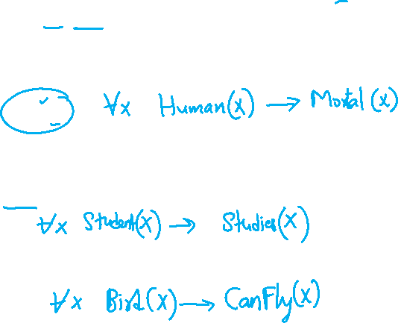
Universal and Existential quantifier
Quantifiers ∀ and ∃
  ∀ - For all: make statement about every object
    ∀x P(x) is read “For all x’es, P (x) is true”
    P is true for every object x, where P is a logical sentence
    E.g., All humans are mortal.
∀x P(x)
Every student studies
All birds can fly

Slide 22
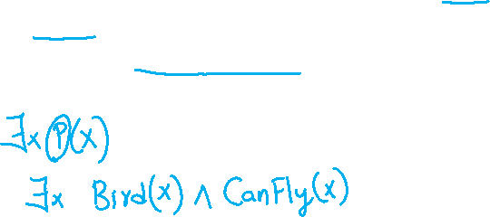
Universal and Existential quantifier
Quantifiers ∀ and ∃
  ∃ - There Exists:make statement about some object
    ∃x P(x) is read “there exists an x such that P(x) is true”.
    P is true for atleast one object x, where P is a logical sentence
    E.g.,Some birds can fly
Notes:
There exists at least one object x such that x is a bird and x can fly.

Slide 23
Universal and Existential quantifier
  Connections between the quantifiers:
  The two quantifiers are actually intimately connected with each other, through negation.
“Everyone likes ice cream” means that there is no one who does
not like ice cream:

Slide 24
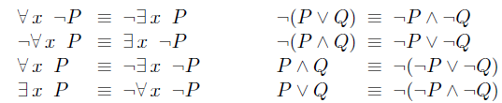
Universal and Existential quantifier
    ∃x P(x) ≡ ¬ (∀x¬P(x))
There exists an x such that P(x) is true
is the same as
It is not true that P(x) is false for all x.
The De Morgan rules for quantified and unquantified sentences are as follows:

Slide 25
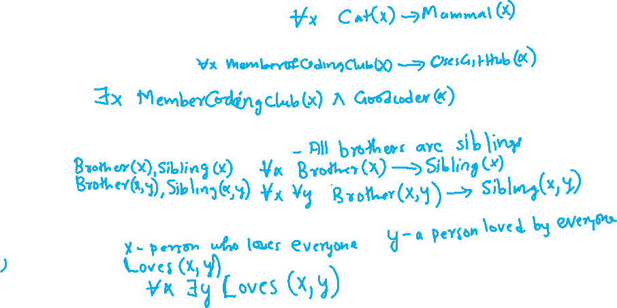
Examples -
Write down the predicate Logic for the following
All cats are mammals -
Everyone in the coding club uses Github-
Someone in the coding club is a good coder –
Nested quantifiers –
1) Brothers are siblings
Mixtures
1) Everybody loves somebody

Slide 26
Examples
All cats are mammals - ∀x Cats(x) => Mammals(x)
  for all x, if x is a cat, then x is a mammal
Everyone in the coding club uses Github -
∀x MemberOfClub(x) => UsesGitHub(x)
Someone in the coding club is a good coder -
∃x MemberOfClub(x) ∧ GoodCoder(x)
Nested quantifiers - ∀ x ∀ y Brother(x, y) ⇒ Sibling(x, y)
mixtures
∀x ∃y Loves(x, y) - Everybody loves somebody
∃y ∀x Loves(x, y) - There is someone who is loved by everyone

Slide 27
Try
All food are edible
One's mother is one's female parent
Richard has at least two brothers

Slide 28
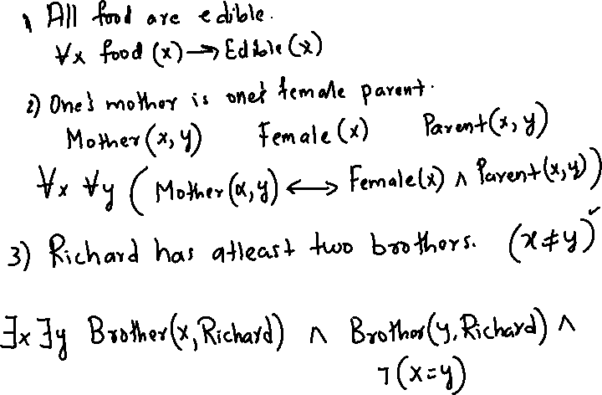
*

Slide 29
Try
All food are edible
∀ x food( x) => edible( x)
Brothers are siblings
One's mother is one's female parent
Richard has at least two brothers
∃x ∃ y Brother(x, Richard) ∧ Brother(y, Richard)
(why?)
∃x Vy Brother(x, Richard) ∧ Brother(y, Richard) ∧ ¬(x = y)

Slide 30
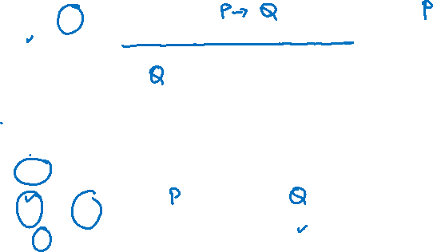
Rules from Propositional Logic
Rule | Meaning | Example
Modus Ponens (→-Elimination) | If P → Q and P, infer Q | Student(Joe) → Copies(Joe) and Student(Joe) ⇒ Copies(Joe)
Modus Tollens | If P → Q and ¬Q, infer ¬P | If Dog(x) → Barks(x) and ¬Barks(x) ⇒ ¬Dog(x)
And-Introduction / Elimination | From P and Q infer P ∧ Q; from P ∧ Q infer P or Q | Student(Alice), Likes(Alice,Math) infer Student(Alice) ∧ Likes(Alice,Math)
Or-Introduction / Elimination | From P infer P ∨ Q | (Student(Alice)) infer Student(Alice) ∨ PlaysGuitar(Alice)

Slide 31

Quantifier Rules
Rule | Also called | Meaning
Universal Elimination (∀-Elim) | Instantiation | From ∀x P(x) infer P(a) for any constant a
Universal Introduction (∀-Intro) | Generalization | If you proved P(a) for an arbitrary a, you may infer ∀x P(x)
Existential Introduction (∃-Intro) |  | From P(a) infer ∃x P(x)
Existential Elimination (∃-Elim) | Instantiation with fresh variable | From ∃x P(x) infer P(c) (with a new constant c), then reason with it

Slide 32
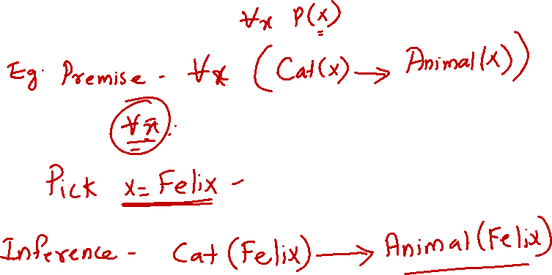
Universal elimination

Slide 33
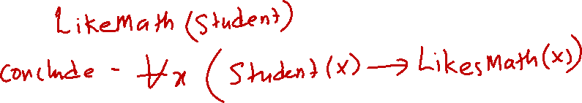
Universal Introduction/Generalization

Slide 34
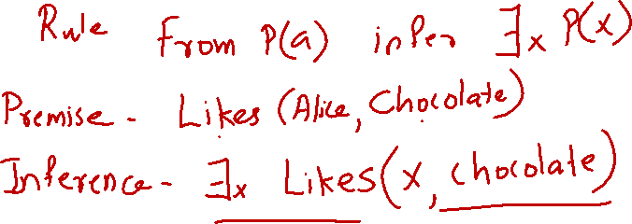
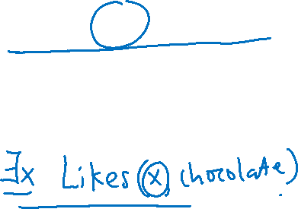
Existential Introduction
Notes:
If a property is true for a particular individual, then there exists at least one individual having that property.

Slide 35
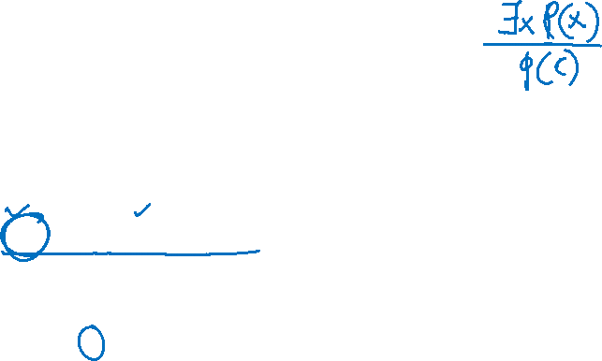
Existential Elimination
∃x P(x)⇒P(c)
where c is a fresh constant.
Premise:
∃x Likes(x,Chocolate)
Introduce a fresh constant c
Likes(c,Chocolate)
Here, c represents an unknown individual who likes chocolate.
Notes:
There exists someone → let us give that someone a fresh temporary name and reason with it.”

Slide 36

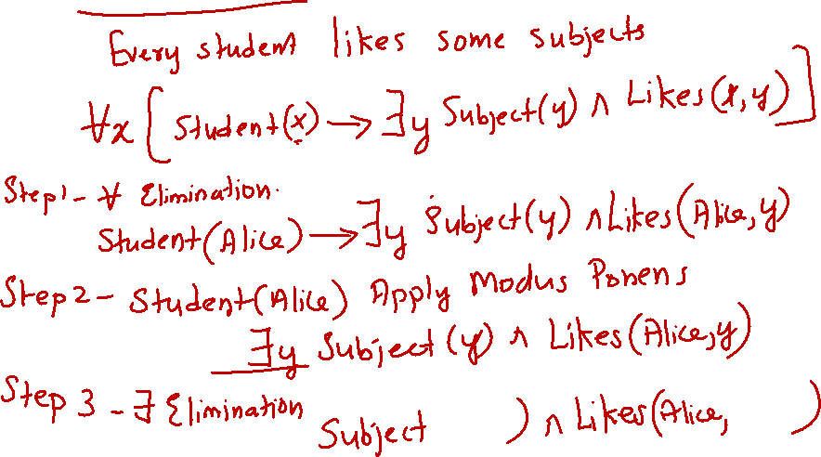

Combined example
Notes:
for every x, if x is a student, then there exists some y such that y is a subject and x likes y."

Slide 37
Example of inference rules
It is a crime for a student to copy music.
Richard is a student.
Every student copies some music
Goal : Show Richard a criminal?
Convert to FOL premises and prove

Slide 38
FOL premises
∀x ∀y (Student(x) ∧ Music(y) ∧ Copies(x,y) → Criminal(x))
Student(Richard)
∀x (Student(x) → ∃y (Music(y) ∧ Copies(x,y)))

Slide 39

FOL premises
∀x ∀y (Student(x) ∧ Music(y) ∧ Copies(x,y) → Criminal(x))
Student(Richard)
∀x (Student(x) → ∃y (Music(y) ∧ Copies(x,y)))
Step 1 - ∀-elimination on premise 3
(substituting x = Richard)
Student(Richard) → ∃y (Music(y) ∧ Copies(Richard,y))
Step 2 - Modus Ponens, using Step 1 and premise (Student(Richard))
∃y (Music(y) ∧ Copies(Richard,y))

Slide 40

Step 3 - Existential elimination.
Introduce a fresh constant, Song1, that hasn't appeared anywhere else in the proof
Music(Song1) ∧ Copies(Richard, Song1)
Step 4 -∀-elimination (twice) on premise 1
substituting x = Richard, y = Song1
Student(Richard) ∧ Music(Song1) ∧ Copies(Richard,Song1) → Criminal(Richard)
Step 5 - Conjunction Introduction.
Combine premise 2 (Student(Richard)) with the result of Step 3 (Music(Song1) ∧ Copies(Richard,Song1)) to build the full antecedent needed for Step 4
Student(Richard) ∧ Music(Song1) ∧ Copies(Richard,Song1)

Slide 41
Step 6 - Modus Ponens, using Step 4 and Step 5
Criminal(Richard)
Therefore Richard is a criminal

Slide 42
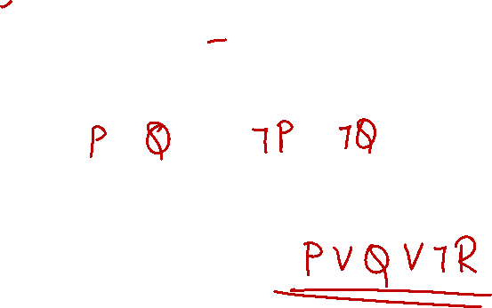
Literal and Clause
1) Literal: A basic proposition or its negation
Example: P,Q,¬P,¬Q.
2) Clause: A disjunction (OR) of literals
Example: (P ∨ ¬Q ∨ R).
Knowledge base in resolution = a set of clauses.

Slide 43
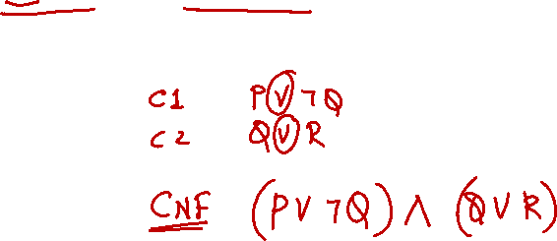
Conjunctive Normal Form (CNF)
Conjunctive normal form is a standard way of representing a logical formula.
A conjunction (AND, ∧) of one or more clauses, where each clause is a disjunction (OR, ∨) of literals.
Example:
Clause 1: (P ∨ ¬Q)
Clause 2: (Q ∨ R)
CNF: (P ∨ ¬Q) ∧ (Q ∨ R)

Slide 44
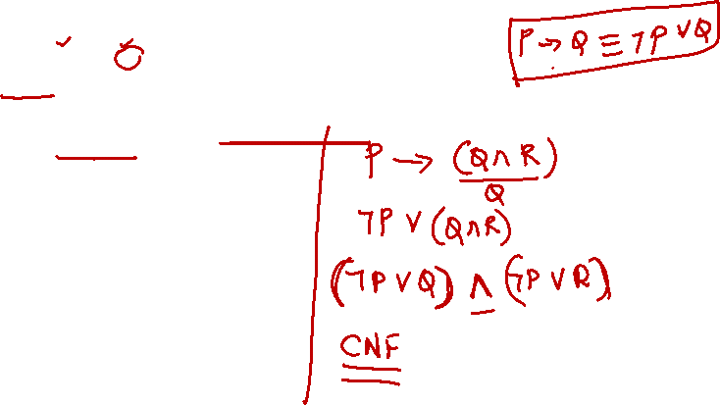
Converting to CNF (Steps)
1) Remove ↔ and →
2) Push ¬ inside (De Morgan, double negation)
3) Distribute ∨ over ∧
4) Collect as AND of ORs (clauses)
Eg: Convert P→(Q∧R)
Step 1: Eliminate →
¬P∨(Q∧R)
Step 2: Distribute OR over AND
(¬P∨Q)∧(¬P∨R)

Slide 45
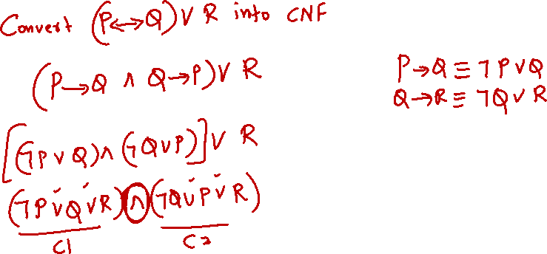

Slide 46
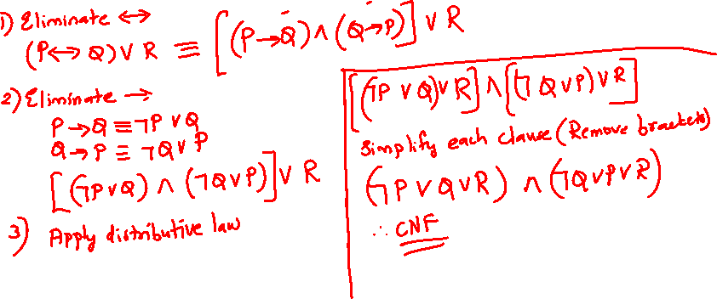
Example
2) Convert (P↔Q)∨R into CNF

Slide 47

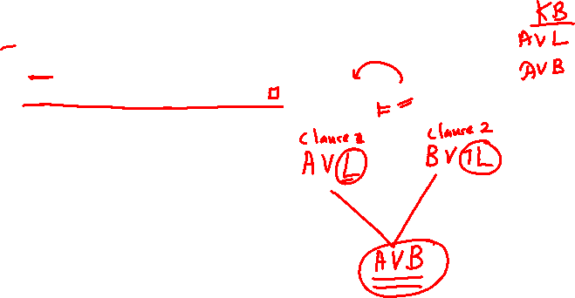
Proof by Resolution in Propositional Logic
To prove a sentence α:
  Add its negation ¬α to the Knowledge Base (KB).
  If this leads to a contradiction (empty clause □), then KB ⊨ α.
Resolution Rule
- Combine the rest into a new clause (resolvent).
Since the resolution process derives the empty clause □, a contradiction, our assumption that ¬α was true must be false, logically proving that α is true and can therefore be consistently added to the Knowledge Base.

Slide 48
Since the resolution process derives the empty clause, a contradiction, our assumption that ¬α was true must be false, logically proving that α is true and can therefore be consistently added to the Knowledge Base.

Slide 49
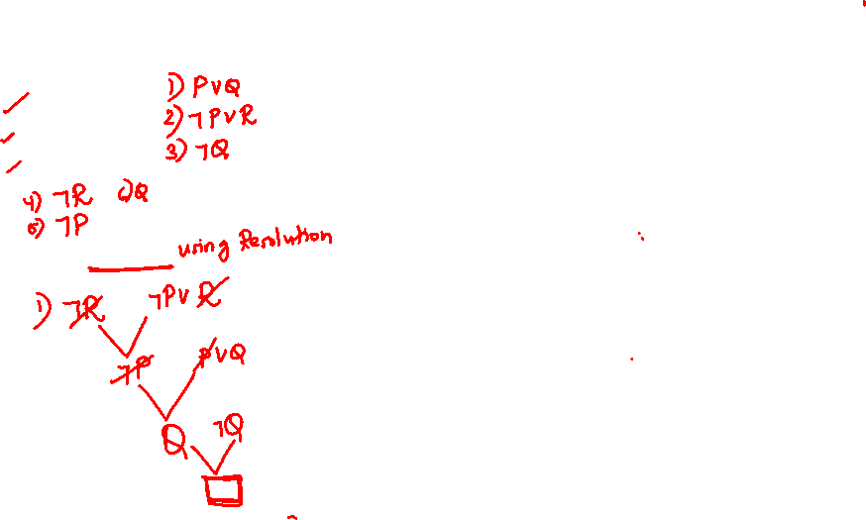
Example
Steps:
Add negation of query: ¬R.
Resolve (2) and (¬R): ⇒ ¬P.
Resolve (1) and (3): ⇒ P.
Resolve (P) and (¬P): ⇒ □ (contradiction)
Therefore, R is entailed.
KB:
1) P∨Q
2) ¬P∨R
3) ¬Q
Query: Prove R.

Slide 50
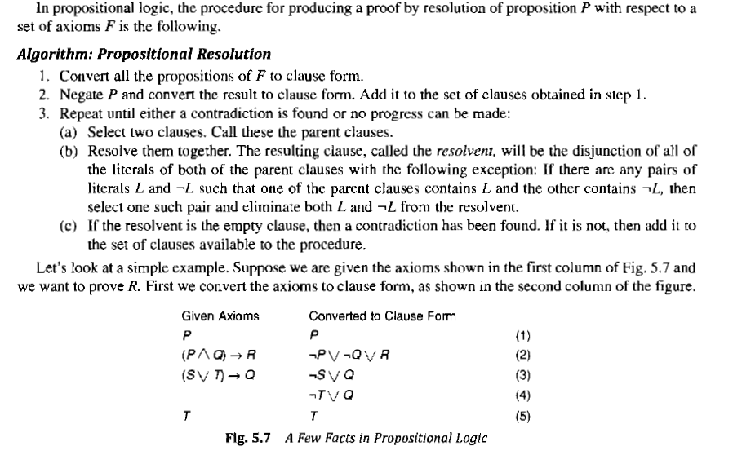
Resolution in Propositional Logic

Slide 51
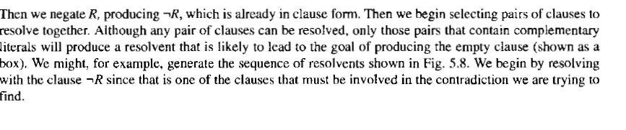
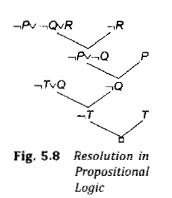
Resolution in Propositional Logic

Slide 52
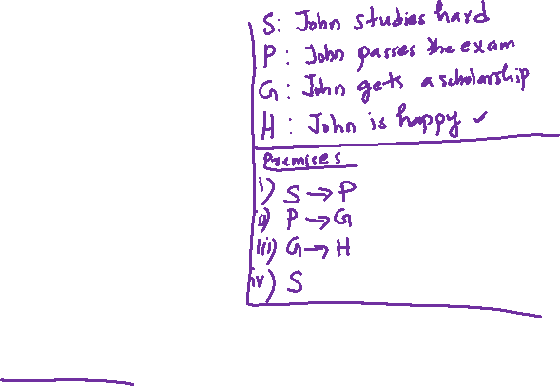
Example
Consider the following knowledge base premises,
i. If John studies hard, then he will pass the exam.
ii. If John passes the exam, then he will get a scholarship.
iii. If John gets a scholarship, then he will be happy.
iv. John studies hard.
a. Represent each sentence using appropriate propositional symbols.
b. Using resolution, prove that John is happy, logically follows from the knowledge base.

Slide 53
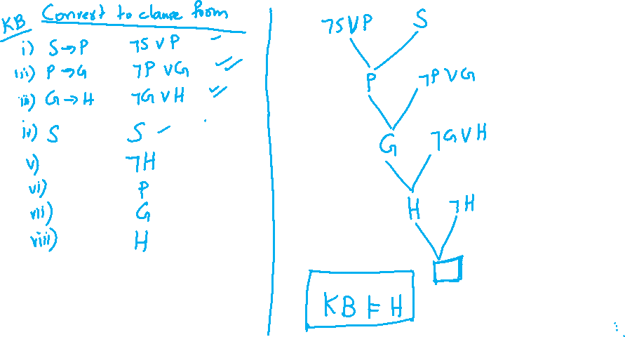

Slide 54
Resolution in Predicate Logic
An advantage for resolution over forward chaining is that resolution is a complete and sound method for automated theorem proving in First-Order Logic, while forward chaining is only complete for Horn clauses.
This means that resolution can prove any valid logical statement, making it a more powerful and general reasoning technique, especially for complex problems that cannot be expressed solely with Horn clauses.

Slide 55

Resolution
Given Sentences:
1) All humans are mortal.
∀𝑥(𝐻𝑢𝑚𝑎𝑛(𝑥)→𝑀𝑜𝑟𝑡𝑎𝑙(𝑥))
2) Socrates is a human.
𝐻𝑢𝑚𝑎𝑛(𝑆𝑜𝑐𝑟𝑎𝑡𝑒𝑠)
3) We want to prove:𝑀𝑜𝑟𝑡𝑎𝑙(𝑆𝑜𝑐𝑟𝑎𝑡𝑒𝑠)
So the goal is to show that Socrates is mortal using resolution.

Slide 56
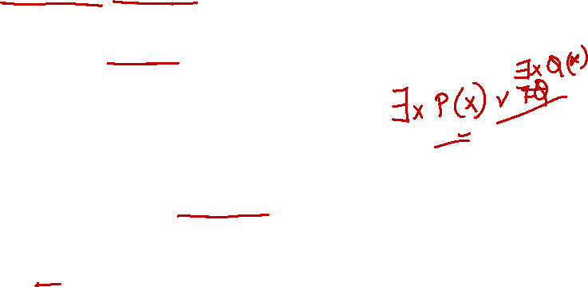
Resolution - First negate the goal and convert everything into clauses.
Step-by-Step Conversion to Clause Form
Step 1: Eliminate implications
∀x(¬Human(x)∨Mortal(x))
Human(Socrates)
Step 2: Move negation inward (if any)
Already done.
Step 3: Standardize variables apart
No variable conflicts so keep as it is.
∀x(¬Human(x)∨Mortal(x))
Step 4 : Move all quantifiers to the left without changing the order
∀x(¬Human(x)∨Mortal(x))

Slide 57

Step-by-Step Conversion to Clause Form (Cont.)
Step 5: Skolemization (remove existential quantifiers)
No existential quantifiers here.
Step 6: Drop universal quantifiers (all variables are implicitly universal)
¬Human(x) ∨ Mortal(x)
Step 7: Distribute ∧ over ∨ if needed
Not needed ,already in disjunction form.
Step 8: Represent as a set of clauses
Clause | Expression
C1 | {¬Human(x) ∨ Mortal(x)}
C2 | {Human(Socrates)}
C3 | {¬Mortal(Socrates)}
Step 9: Rename variables consistently
No renaming needed here.

Slide 58
Recap
Step | Operation | Example Result
1 | Eliminate → | ¬Human(x) ∨ Mortal(x)
2 | Move ¬ inward | same
3 | Standardize | same
4 | Move all quantifiers to the left without changing the order | same
5 | Skolemize | none
6 | Drop ∀ | ¬Human(x) ∨ Mortal(x)
7 | CNF | already CNF
8 | Convert to clauses | {¬Human(x), Mortal(x)}, {Human(Socrates)}, {¬Mortal(Socrates)}
9 | Rename vars | same
10 | Resolution | derive □ → proven

Slide 59
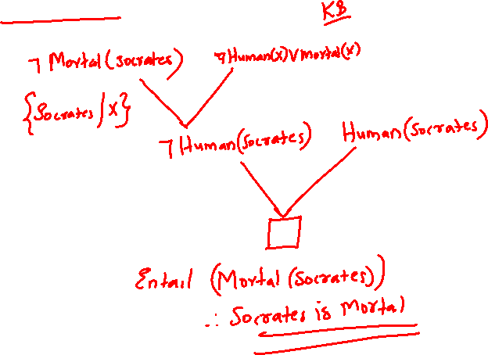

Resolution
Clause | Expression
C1 | {¬Human(x) ∨Mortal(x)}
C2 | {Human(Socrates)}
C3 | {¬Mortal(Socrates)}

Slide 60
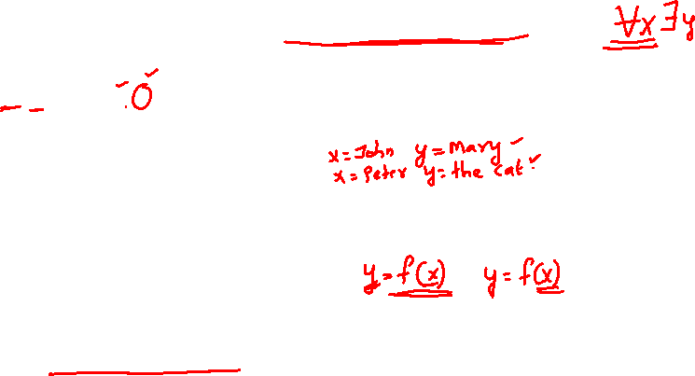

Skolemization
When we remove an existential quantifier (∃) from a statement that depends on a universal quantifier (∀),
we need a way to say “the value depends on something else.”
Example
∀x ∃y Loves(x, y)
For every person x, there exists someone y that x loves.
Here, y is different for each x
Eg: John might love Mary, Peter might love the Cat, etc.
So we can’t just replace y with one constant name.
Instead, we replace it with
y = f(x)
This new term f(x) is called a Skolem function, it represents the person (or thing) that x loves, without naming it directly.

Slide 61
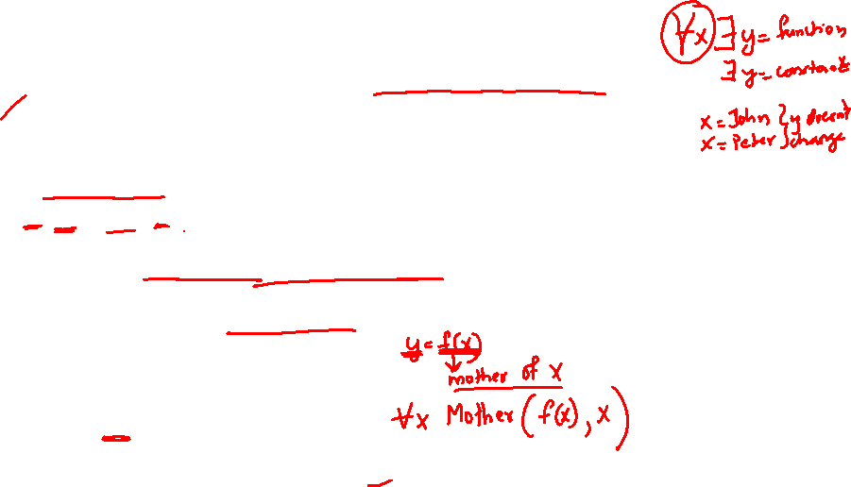
Example
A Skolem constant = one fixed person, means same for everyone.
A Skolem function = one person that depends on who you’re talking about.
Example:
Everyone has a mother
∀x ∃y Mother(y, x)
(For every person x, there exists a y who is the mother of x.)
can’t replace mother with one constant person as it depends on each person.
Remove the existential quantifier (∃y) by introducing a Skolem function because it depends on x. So, y = f(x)
Here, f(x) means -the mother of x.
Now the statement becomes:
∀x Mother(f(x), x)

Slide 62
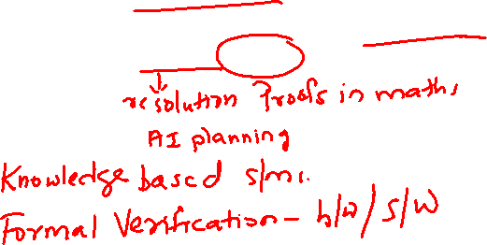
Applications of Resolution
1) Automated Theorem Proving
Resolution is the backbone of many logic-based theorem provers.
Proving theorems in mathematics automatically
e.g., proving properties about integers, sets, or geometry.
Modern tools like Prover9, Vampire are based on resolution.

Slide 63
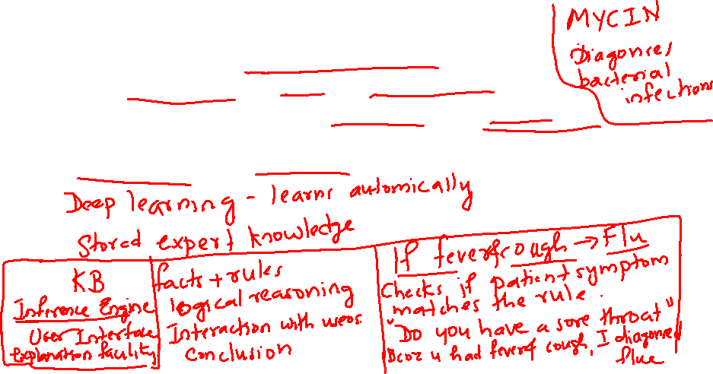
Applications of Resolution (Cont.)
2) Artificial Intelligence – Knowledge Representation
Used in expert systems to infer facts from a knowledge base.
Example: Medical diagnosis systems can use rules to deduce a disease from observed symptoms.
Forward-chaining / backward-chaining resolution are used under the hood.

Slide 64
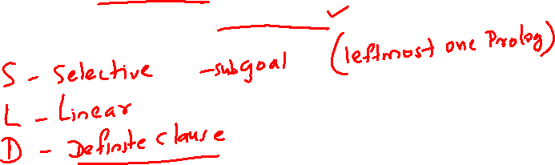
Applications of Resolution (Cont.)
3) Logic Programming
Resolution is the engine of Prolog
  Facts and rules are written as Horn clauses.
  Queries are answered via SLD resolution.

Slide 65
Prolog and Horn clause
It's a clause of the form
If (condition1 AND condition2 AND ... AND conditionN) → then conclusion
Horn Clause = Head :- Body₁, Body₂, ..., Bodyₙ

Slide 66
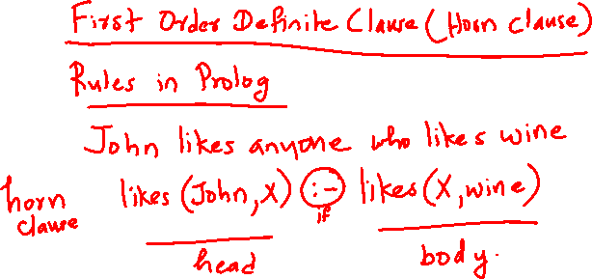

Slide 67
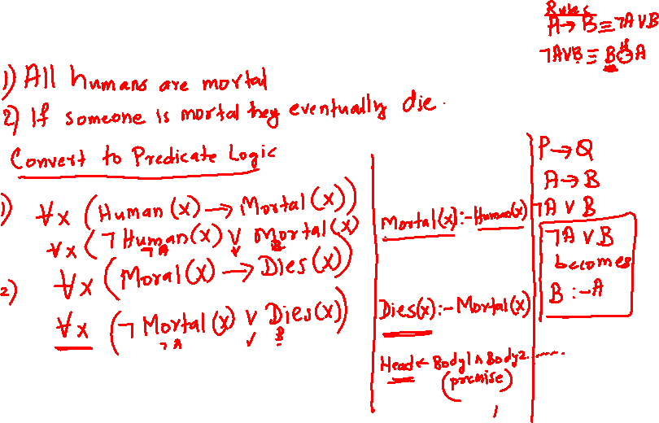

Slide 68
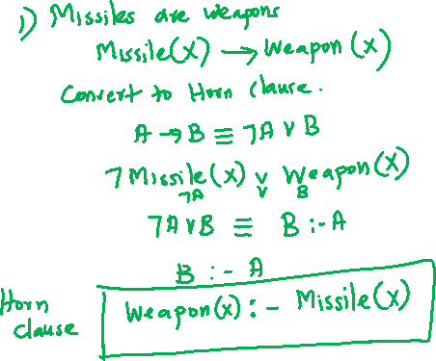

Slide 69
Horn clause form | Logic | Prolog syntax | Example
Fact | conclusion is always true (no conditions) | head. | parent(ravi, meera).
Rule | conclusion is true IF conditions hold | head :- body. | grandparent(X,Y) :- parent(X,Z), parent(Z,Y).
Goal/Query | asking can this be proven? (no conclusion, only conditions) | ?- body. | ?- grandparent(ravi, kiran).

Slide 70
The End…
20

